Slide 1
SAURUSS
Smart
Autonomous
UAV
Recognizer for
Universal
Surveillance
System

Slide 2
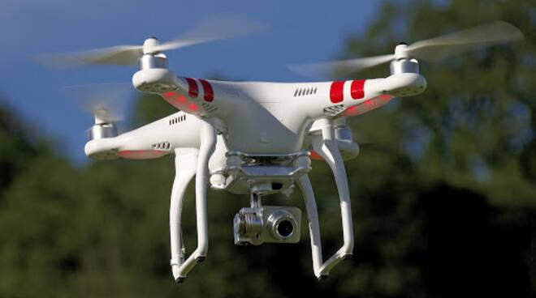
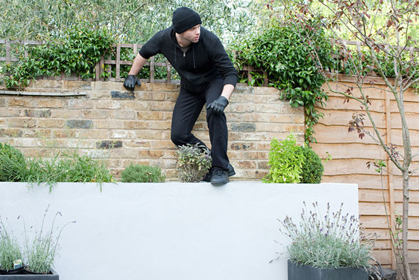
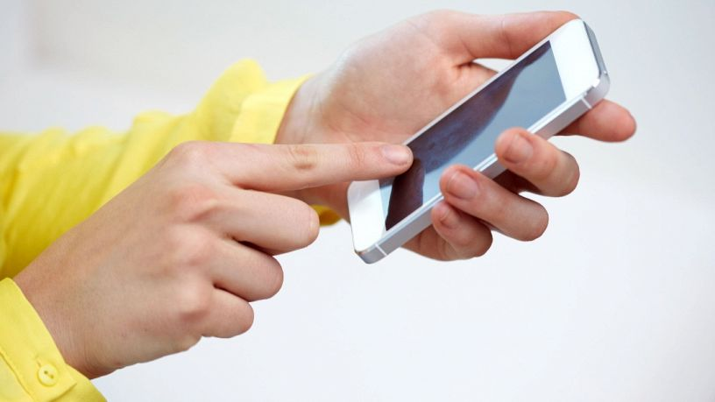

Slide 3
What is SAURUSS?
SAURUSS is an innovative surveillance system that use drones to search and spot intruders
It’s completely autonomous!
It will find threats, capture footage and notify you, keeping you safe... ...and informed

Slide 4
Our System
SAURUSS comes as kit, easy to install and ready to go:
our drone, with his home
our sensors (you can use a custom number of them)
our SAURUSS Hub
our companion phone app: SaurAPP

Slide 5
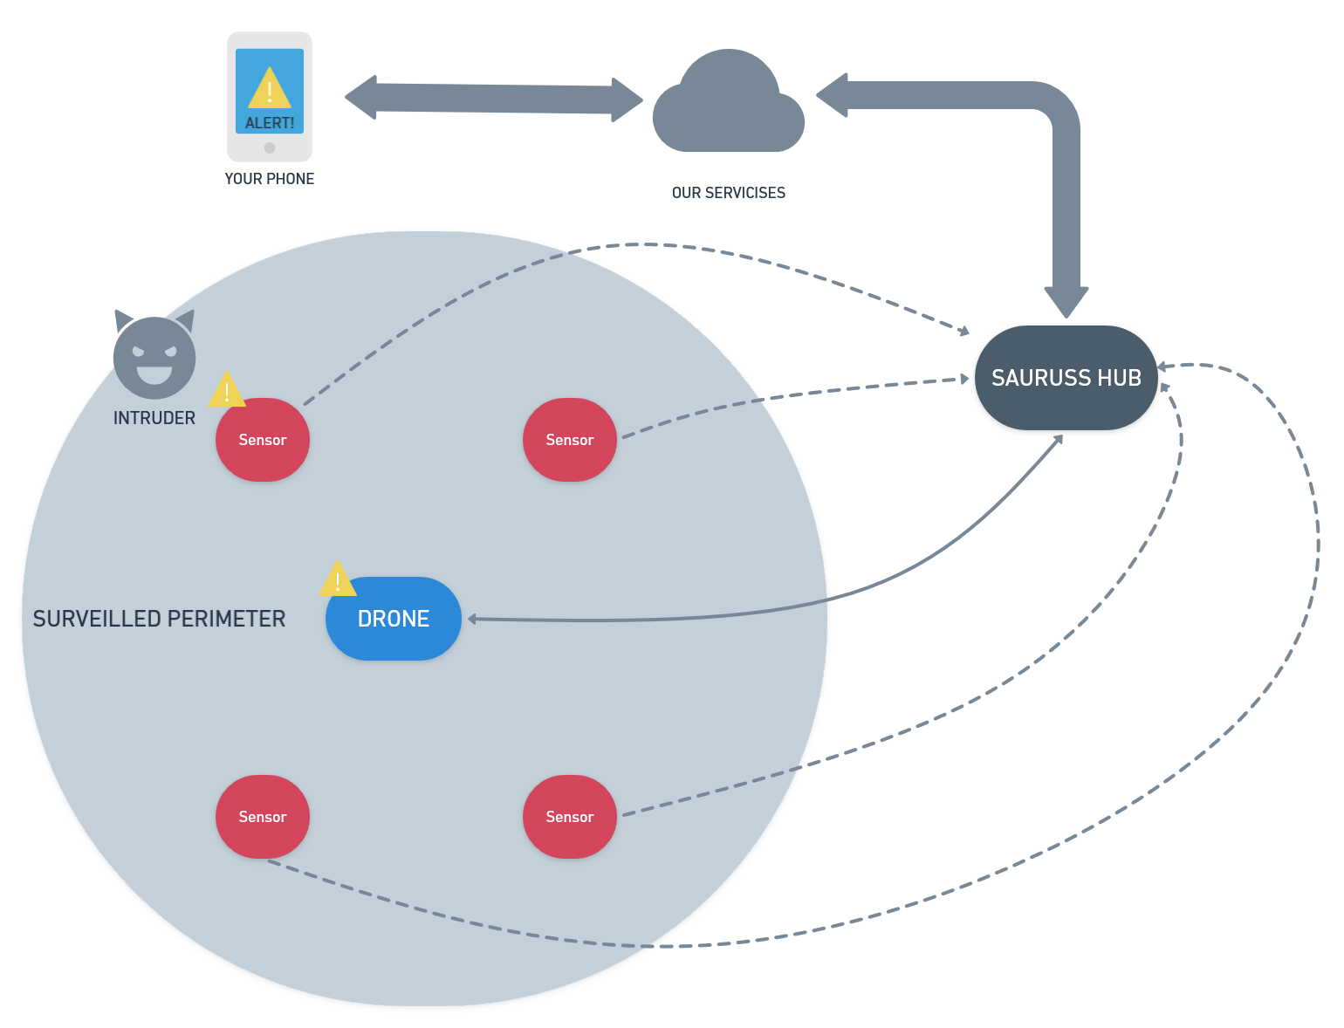
How it Works?
If our sensors sense an intruder inside your surveilled perimeter, our drone will go towards it.
Our smart hub will tell if there is someone dangerous and notify you,through our app, with a pic and video proof! 📸
Say cheese, intruder!

Slide 6
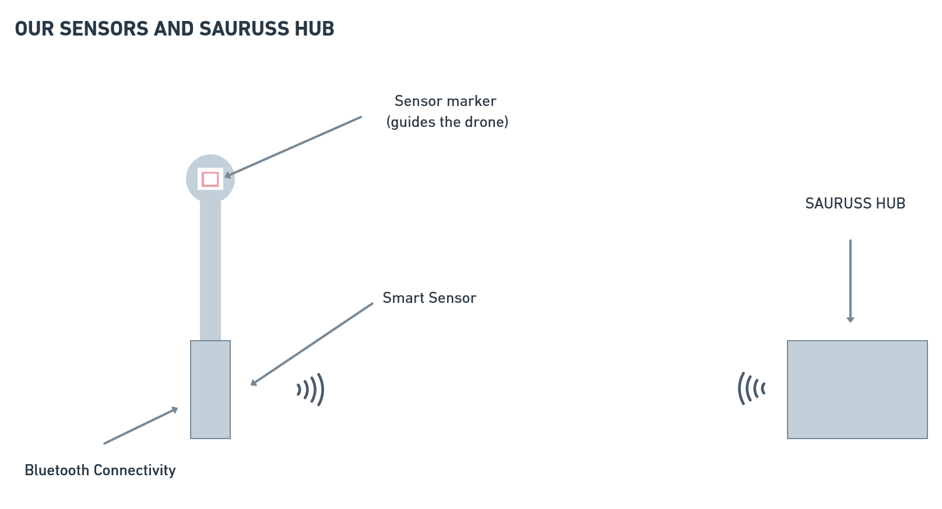

Slide 7
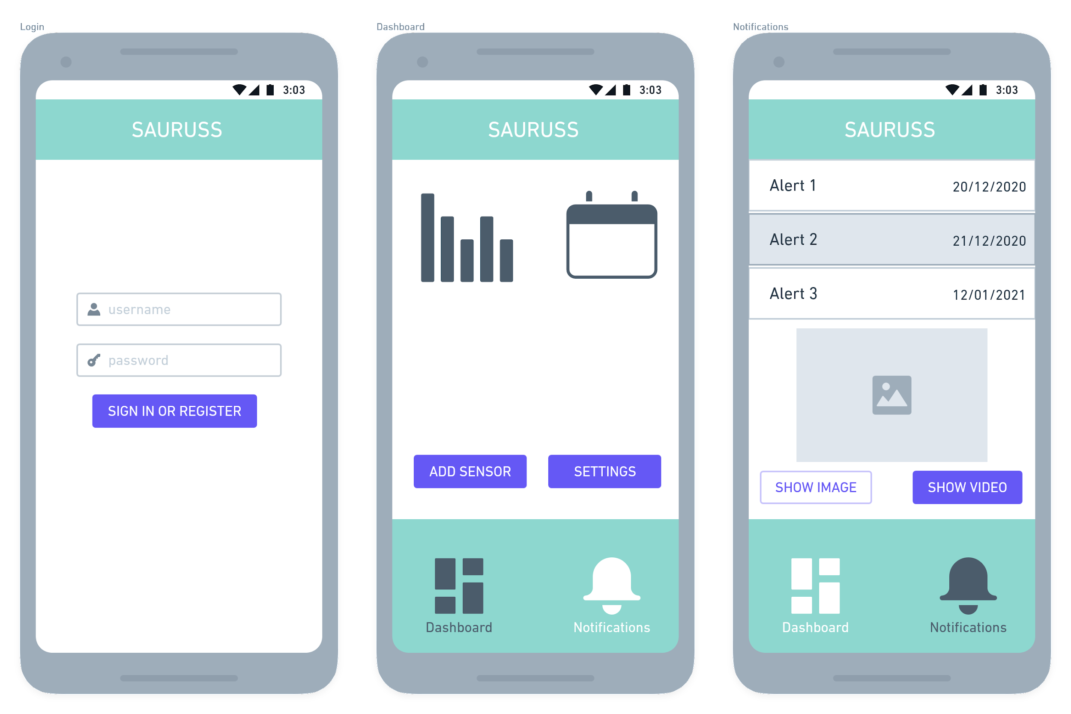
Our companion app: SaurApp
Register and Login
Dashboard: info and scheduling for ON/OFF of SAURUSS Sensors
Notifications: see new and past alerts, get photos and video proofs
Easy setup: scan the QR code on our sensors and you’re done!

Slide 8
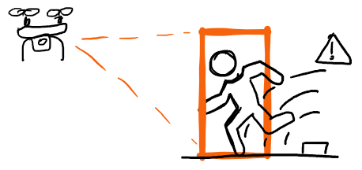
Why SAURUSS ?
Easy Setup
Fully Autonomous
Flexible
private, industrial, military,...
Mobile

Slide 9
HW & SW architecture 🏠
DIFFERENCES BETWEEN FINAL PRODUCT AND OUR PROTOTYPE
HARDWARE AND SOFTWARE USED FOR PROTOTYPE
FULL ARCHITECTURE WITH MAIN FUNCTIONALITIES

Slide 10
From Idea to Prototype: the differences
We used Telegram Bot in conjunction with the companion app for demo purposes (it shows we can easily switch between using a third party service and our cloud server)
We used a drone without a GPS and added Aruco Pose estimation to increase autonomous drive accuracy
We used both Raspberry Pi4 and a Laptop pc for testing and debugging the bridge script

Slide 11
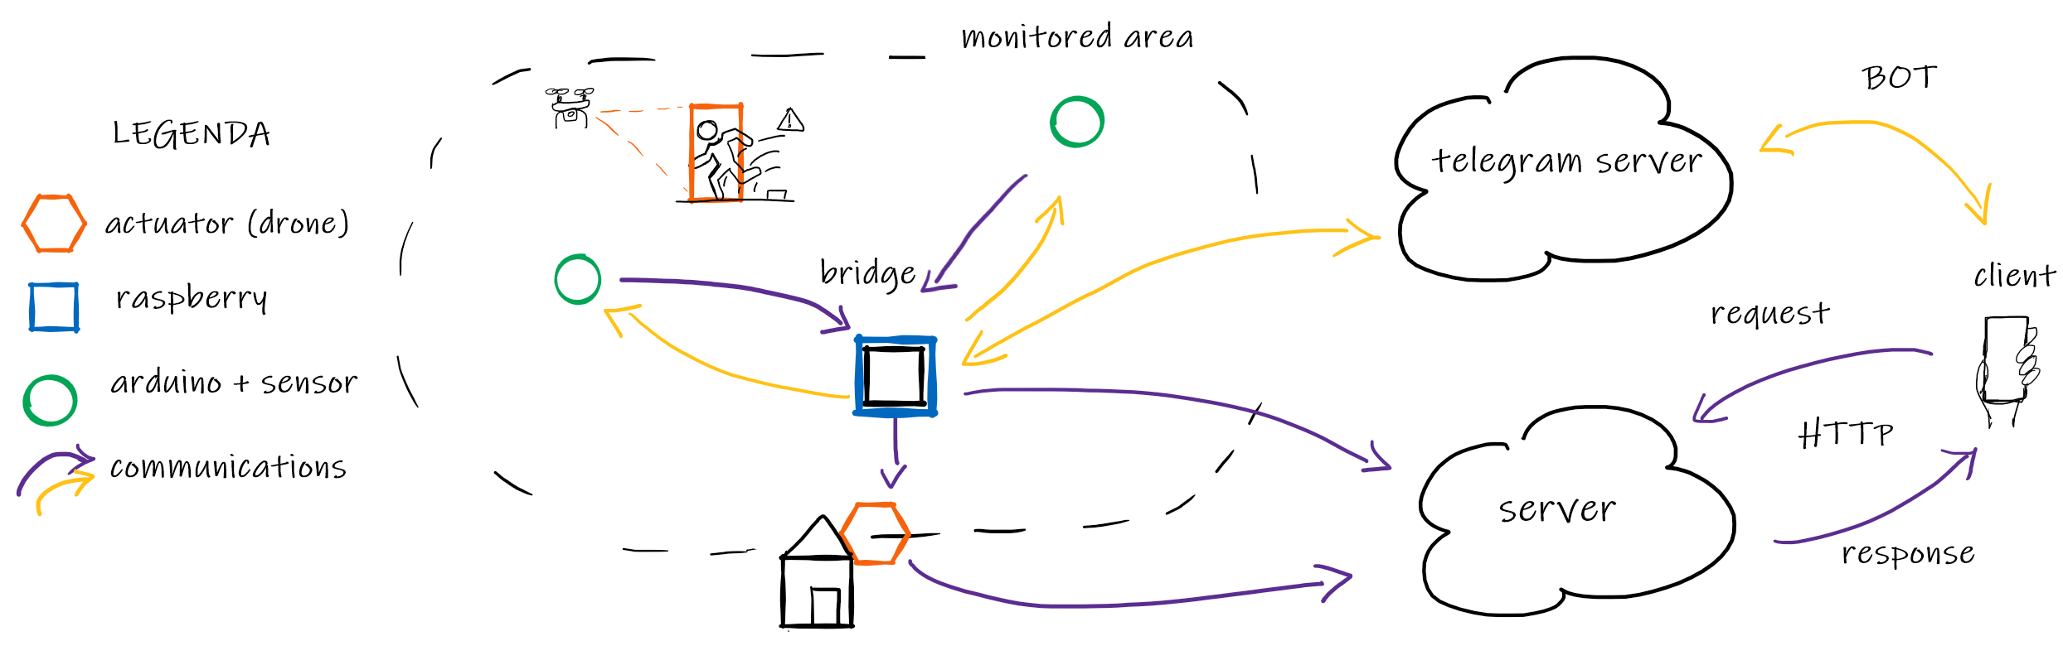
Simplified Architecture

Slide 12
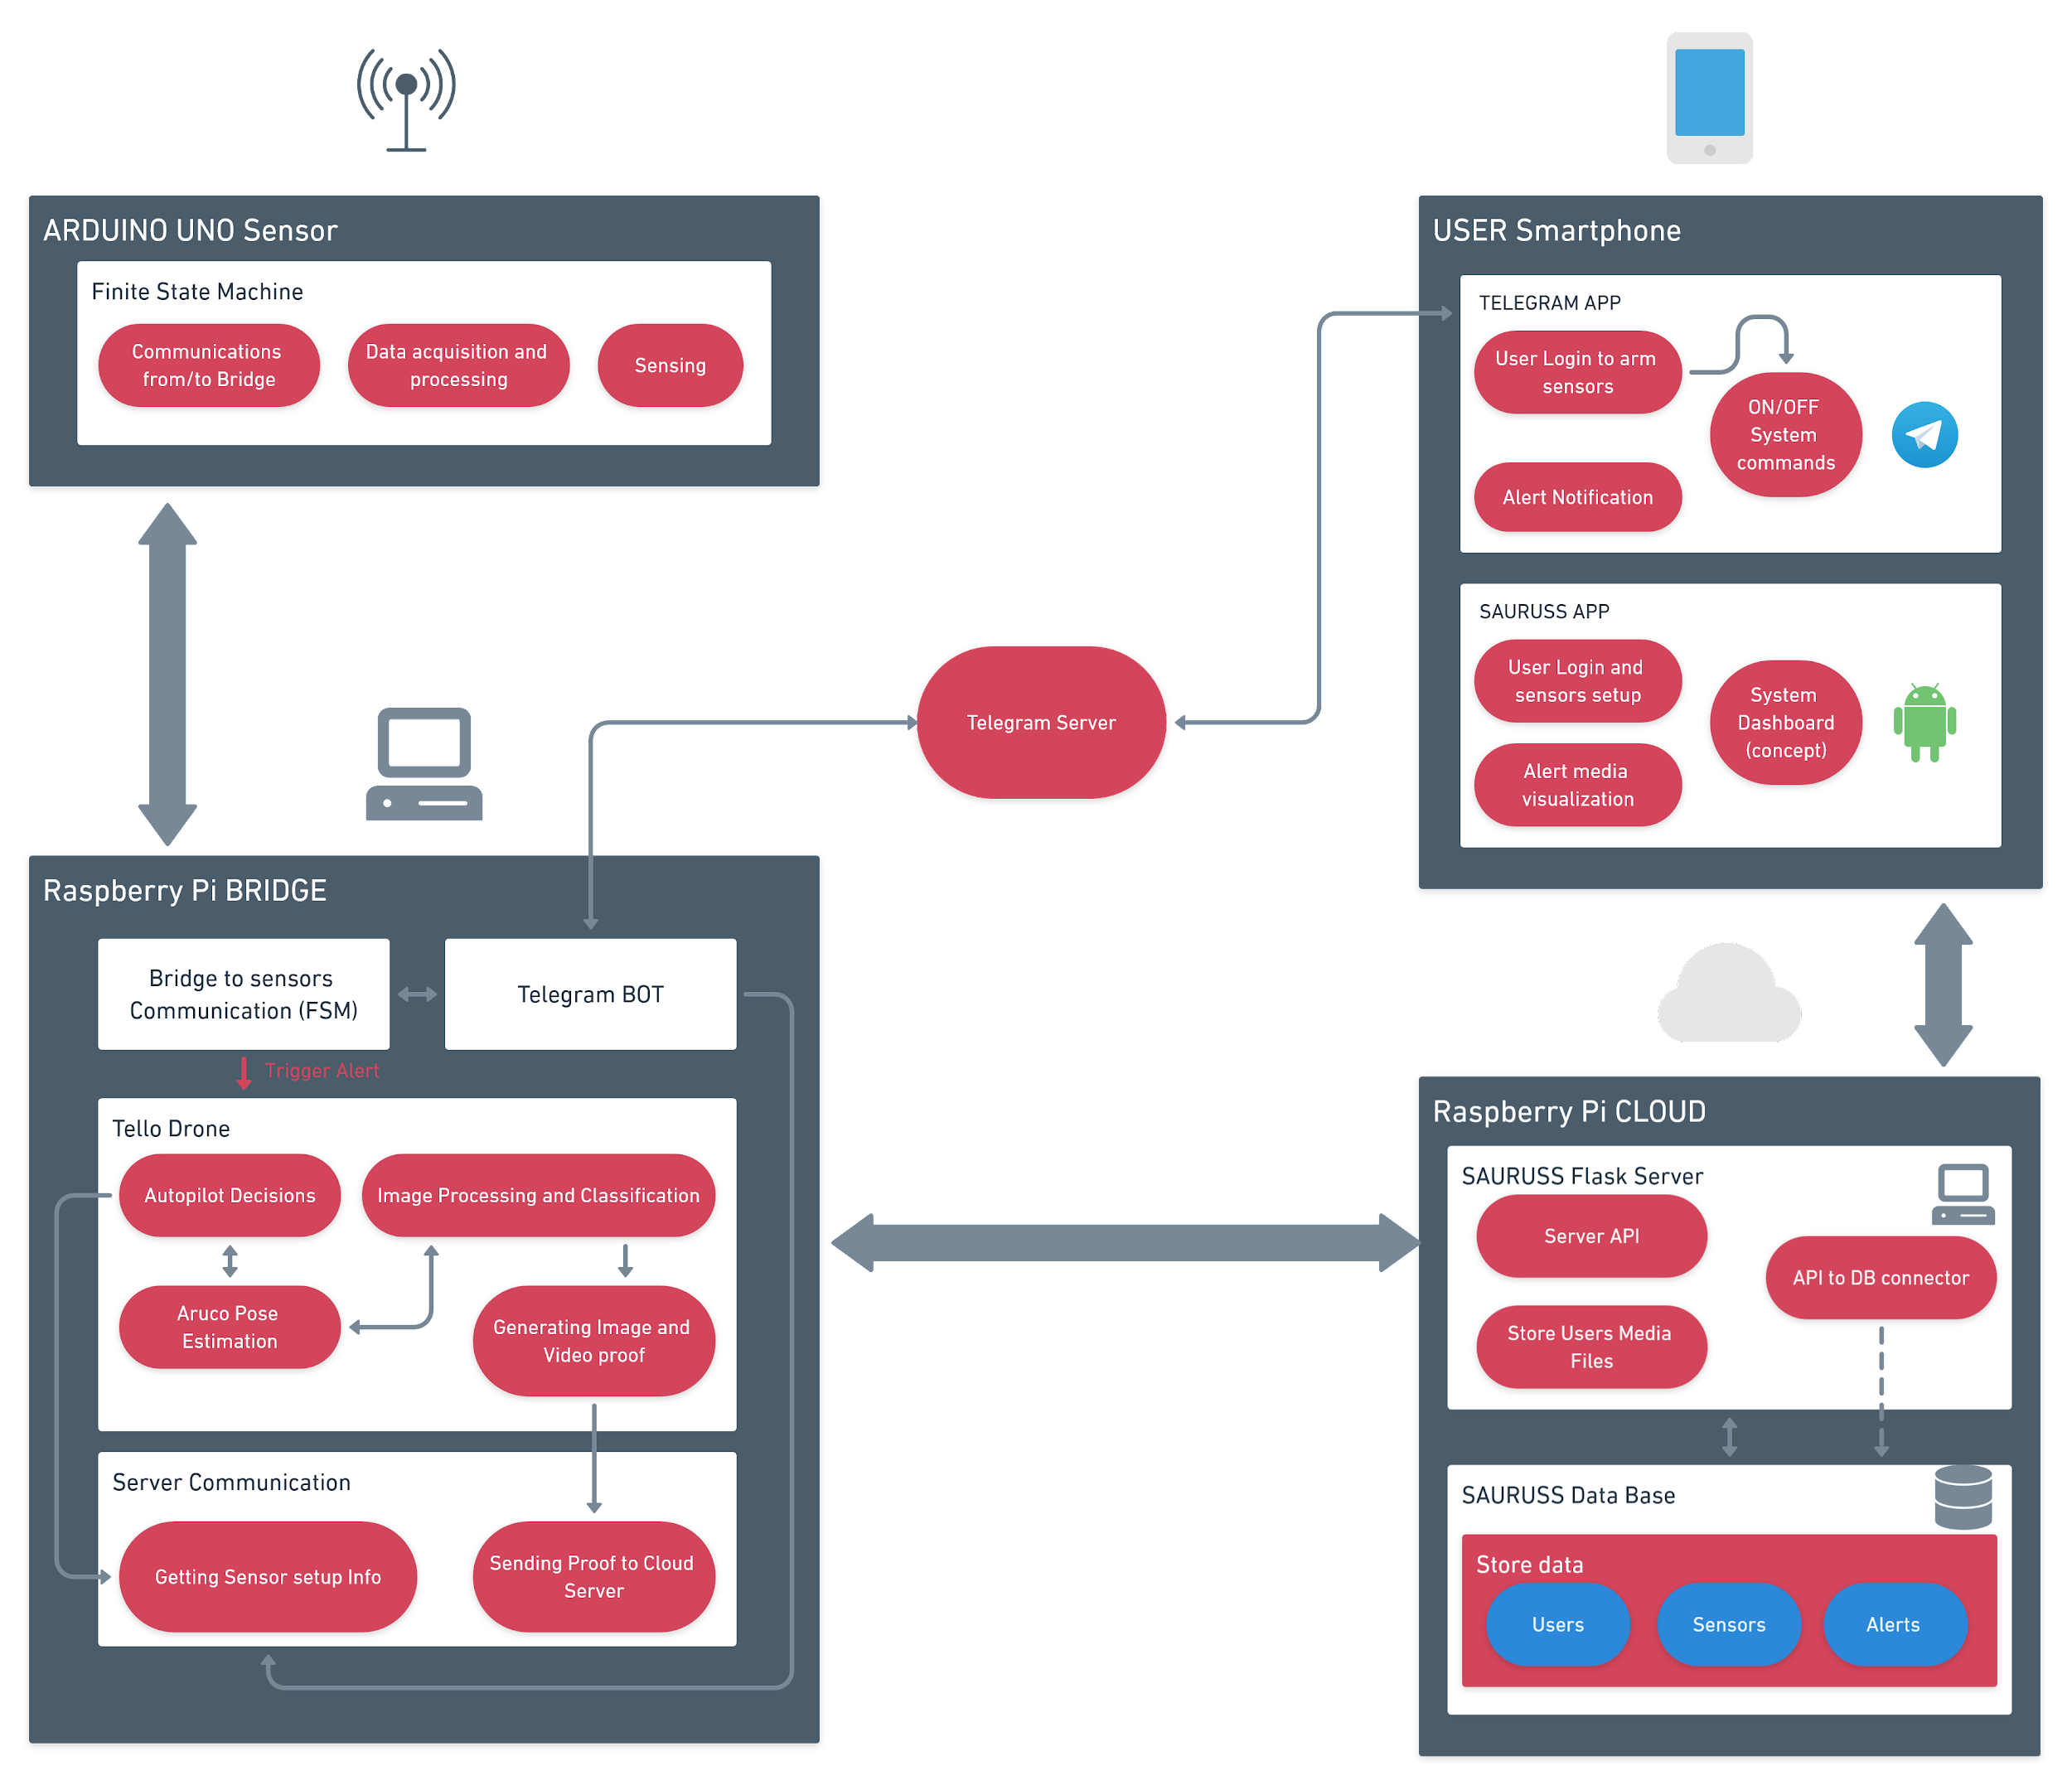

Slide 13







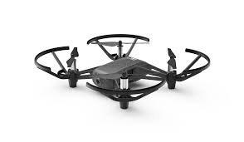


HARDWARE AND SOFTWARE USED

Slide 14
Prototype
Hardware used
Microcontroller (2x) (Sensors Modules) | Arduino UNO Rev. 3
Sensor Hub (Bridge) | Raspberry Pi 4
Server Cloud | Raspberry Pi 2B
Drone (UAV) | DJI Tello EDU
Smartphone (Client) | Android Smartphone
Microntoller Sensors, Comm. Devices, Actuators | PIR proximity sensor, Vibration Sensor,

Slide 15
Technical Talk 🔎
SENSORS AND BRIDGE FSM FOR COMMUNICATIONS
CLIENT APP AND TELEGRAM BOT
BACKEND AND BRIDGE DRONE AUTOMATION

Slide 16
Sensors and Bridge FSM
Why use Finite State Machine patterns?
Robust software
Easy to change/add functionalities
Applicable everywhere

Slide 17
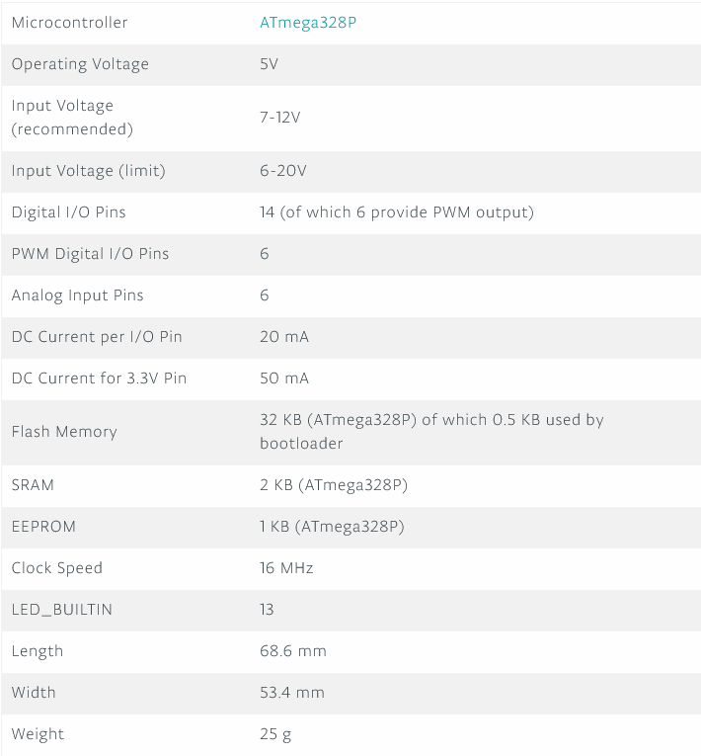
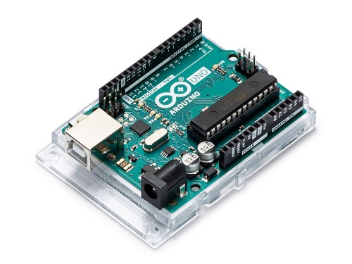
Sensors main board: Arduino UNO Rev. 3
SPECS
Good for quick prototypes
Cheap
Reduced form factor
Plenty of documentation
Low power
VS Code IDE and Arduino IDE
What does it need to do?
Take data from sensors
Elaborate data and decide if to send it
Communicate reliably to Bridge/Listen for Bridge commands

Slide 18
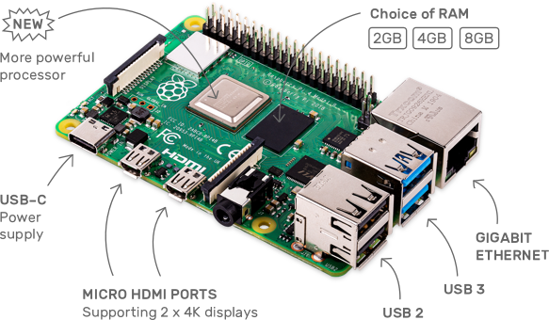
Bridge: Raspberry Pi 4 Model B (4 GB RAM Model)
SPECS
Broadcom BCM2711, Quad core Cortex-A72 (ARM v8) 64-bit SoC @ 1.5GHz
4GB LPDDR4-3200 SDRAM
2.4 GHz and 5.0 GHz IEEE 802.11ac wireless, Bluetooth 5.0, BLE
Gigabit Ethernet
2 USB 3.0 ports; 2 USB 2.0 ports.
Raspberry Pi standard 40 pin GPIO header
Low cost
Low power
Powerful but small
Can handle a little bit of image processing
Wifi + Ethernet + Bluetooth all in one
What does it need to do?
Communicate with Drone (wifi), Sensors (Bluetooth), Server Cloud and Telegram Server (ethernet)
Handle actions when Sensor alert (activate Drone) or telegram bot message
Handle Drone commands, image processing, pose estimation and CNN image classification

Slide 19
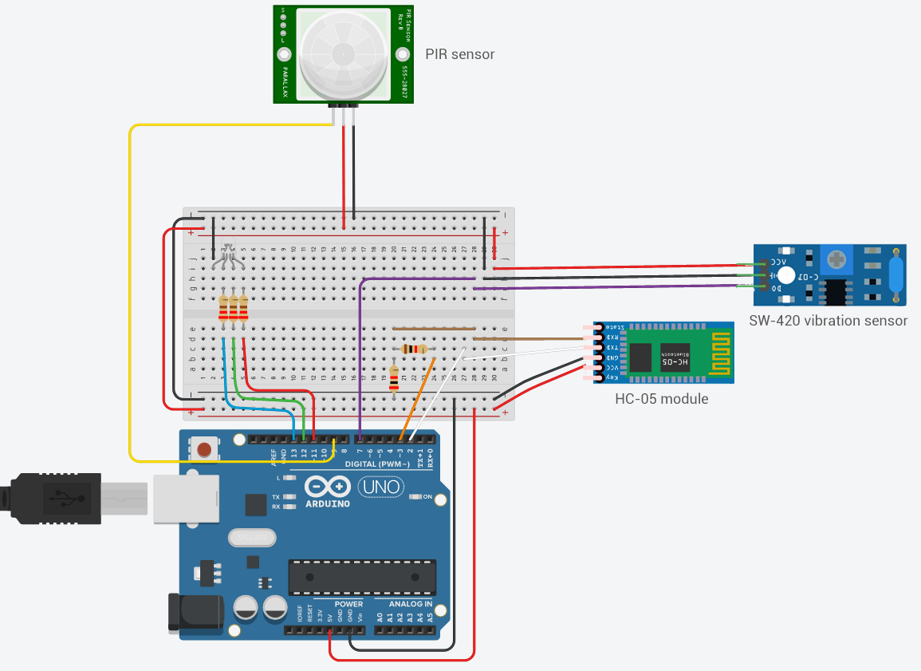
Sensor Prototype Circuit Schematic
Hardware Used
Component Name | Quantity
Arduino UNO Rev. 3 | 1
Breadboard | 1
Resistors | 3 x (220 Ω) 1 x (1㏀) 1 x (2㏀)
RGB LED | 1
HC-05 Bluetooth Module | 1
PIR Proximity Sensor | 1
SW-420 Vibration Sensor | 1

Slide 20
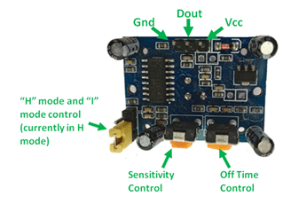
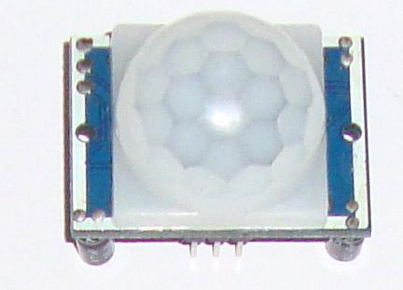
Sensors: PIR
Pin Name | Description
Vcc | Input voltage is +5V for typical applications. Can range from 4.5V- 12V
High/Low Ouput (Dout) | Digital pulse high (3.3V) when triggered (motion detected) digital low(0V) when idle(no motion detected
Ground | Connected to ground of circuit
Repeatable(H) mode
In Repeatable(H) mode the output pin Dout will go high (3.3V) when a person is detected within range and goes low after a particular time (time is set by “Off time control” potentiometer)
Cover distance of about 120° and 7 meters
Low power consumption of 65mA
Output voltage is High/Low (3.3V TTL)
Can understand if there is a living being or not*
*All object with a temperature greater than the absolute zero emit light radiation
Non- Repeatable(L) mode
In “I” mode the output pin Dout will go high (3.3V) when a person is detected within range and will stay high as long as he/she stays within the limit of the Sensors range. Once the person has left the area the pin will go low after the particular time which can be set using the potentiometer

Slide 21
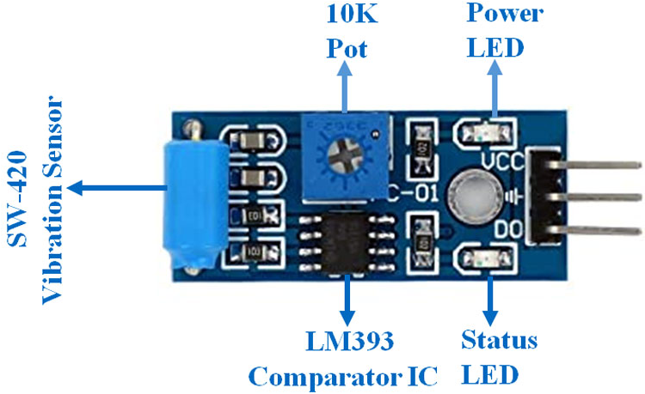
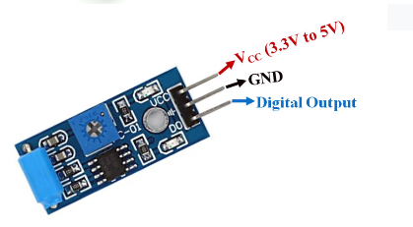
Sensors: Vibration
Output at DO is HIGH when vibration is sensed (status led blinks)
Output is LOW otherwise
Cheap and easy to install thanks to pre-built bolt hole
Low current consumption (15mA)
10 K Pot var. resistor used to set sensibility
Pin Name | Description
VCC | The Vcc pin powers the module, typically with +5V
GND | Power Supply Ground
DO | Digital Out Pin for Digital Output.

Slide 22
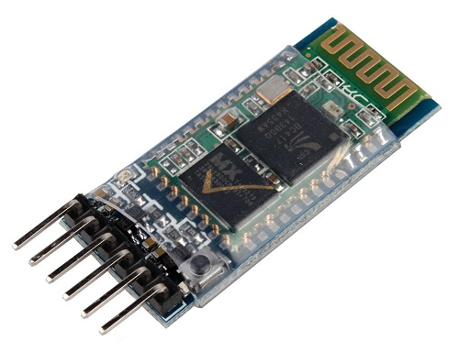
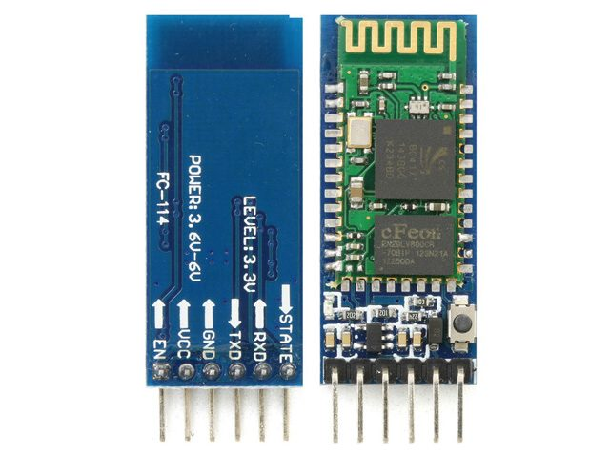
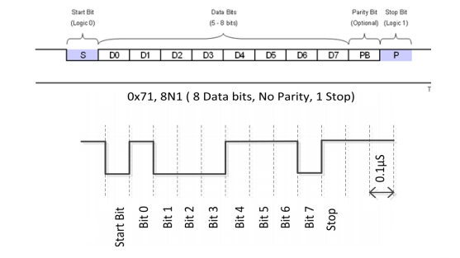
Communication: Bluetooth HC-05 Module
UART Serial to BT 2.0 communication
Based on CSR Bluecore 04 External chip
3,6V to 6V power supply tension, 3.3V data lines (TX-RX), 50mA current consumption
Cheap and easy to use with Software Serial library for Arduino
Asynchronous serial transmission (UART)
Clock is synchronized with data encoding but sender and receiver needs to have same BAUD rate

Slide 23
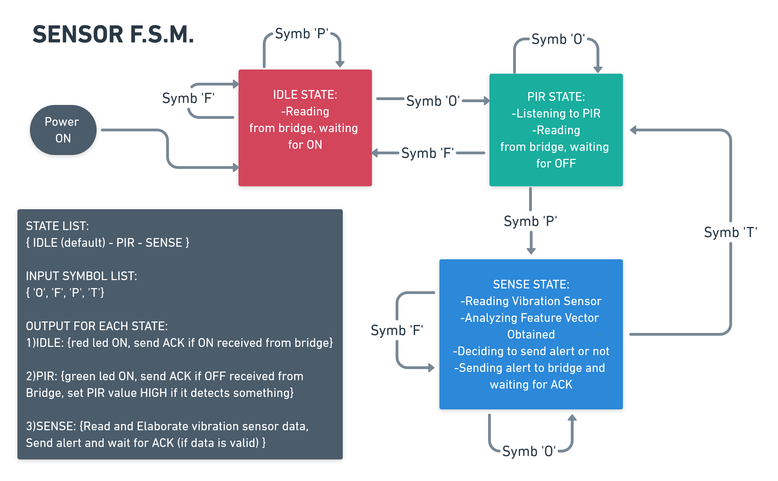

Slide 24
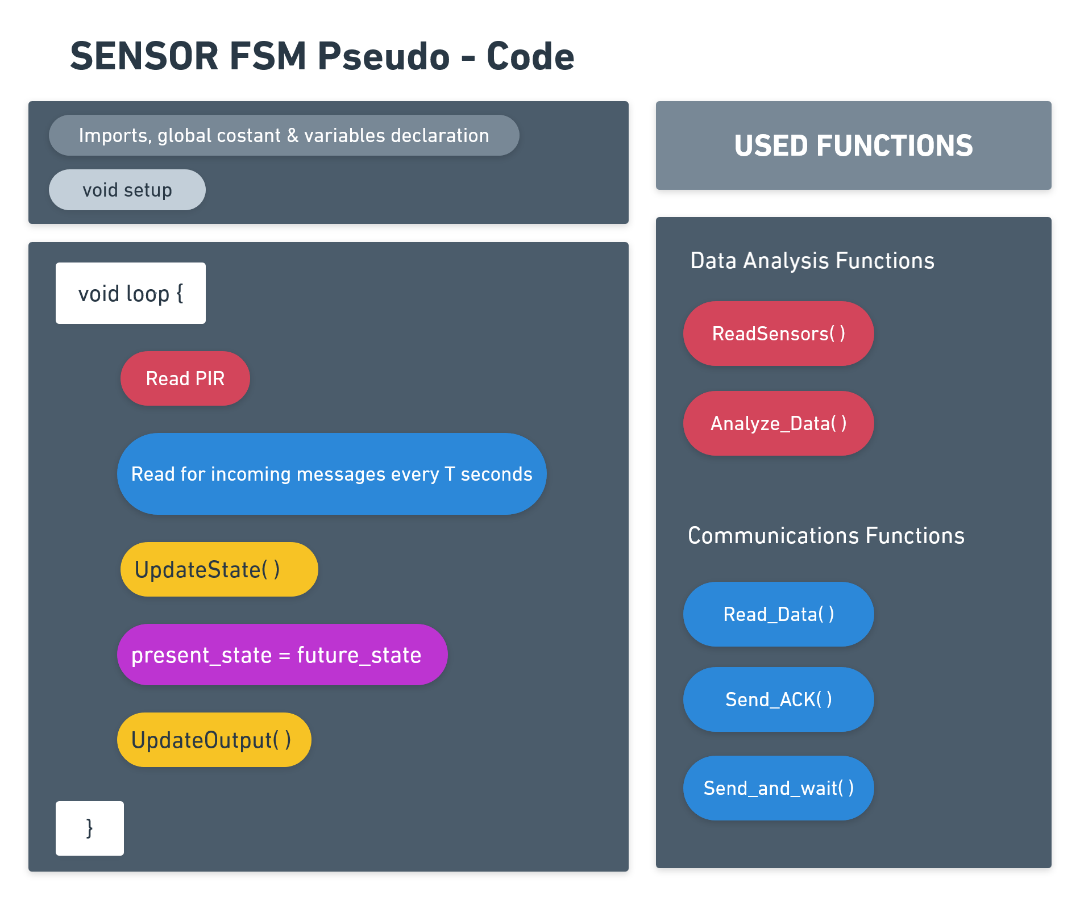

Slide 25

DEMO VIDEO

Slide 26
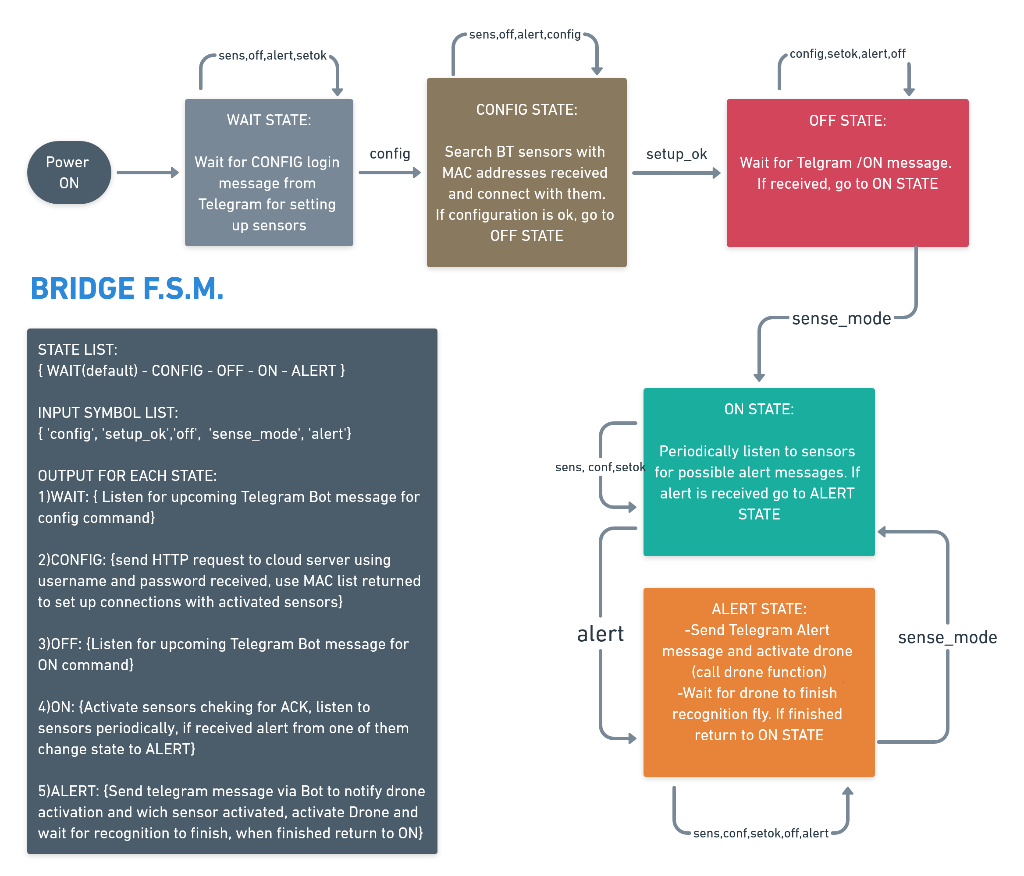

Slide 27
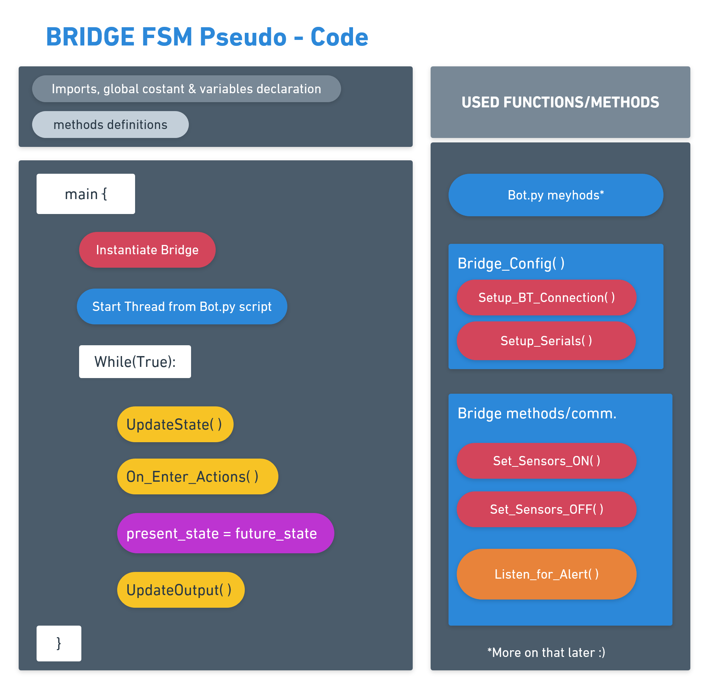

Slide 28
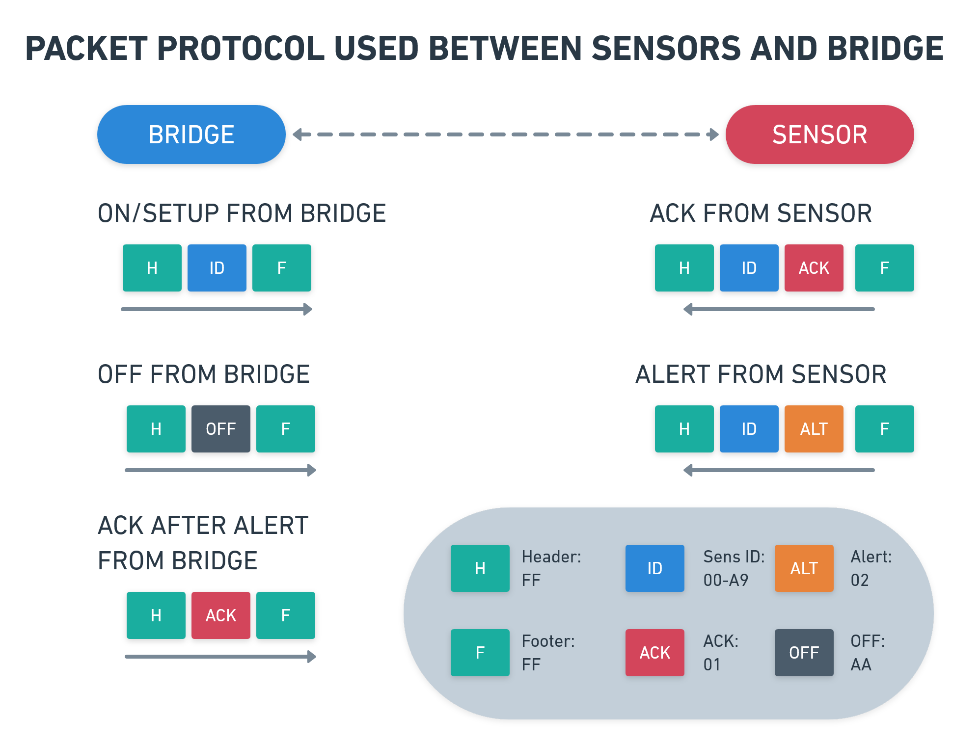

Slide 29
Client APP and Telegram Bot

Slide 30
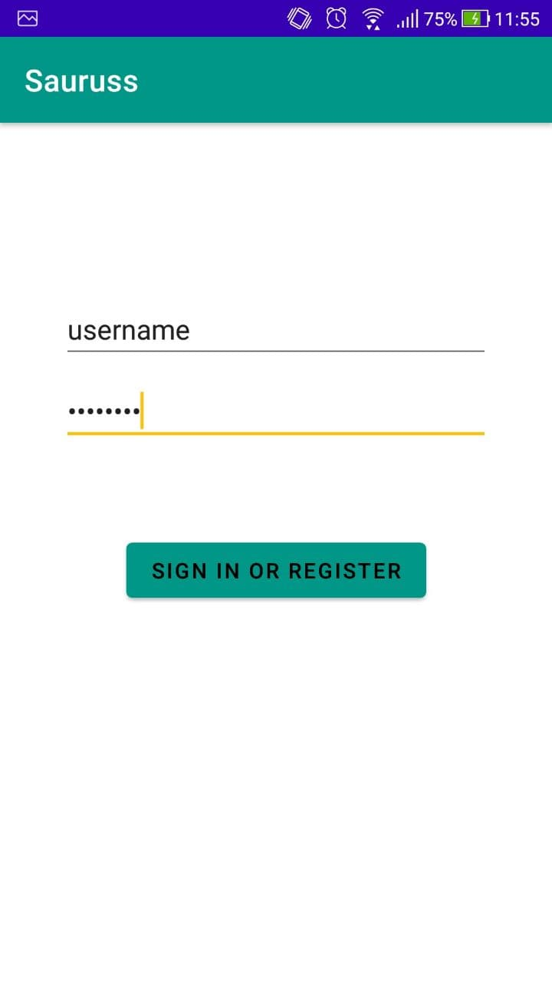
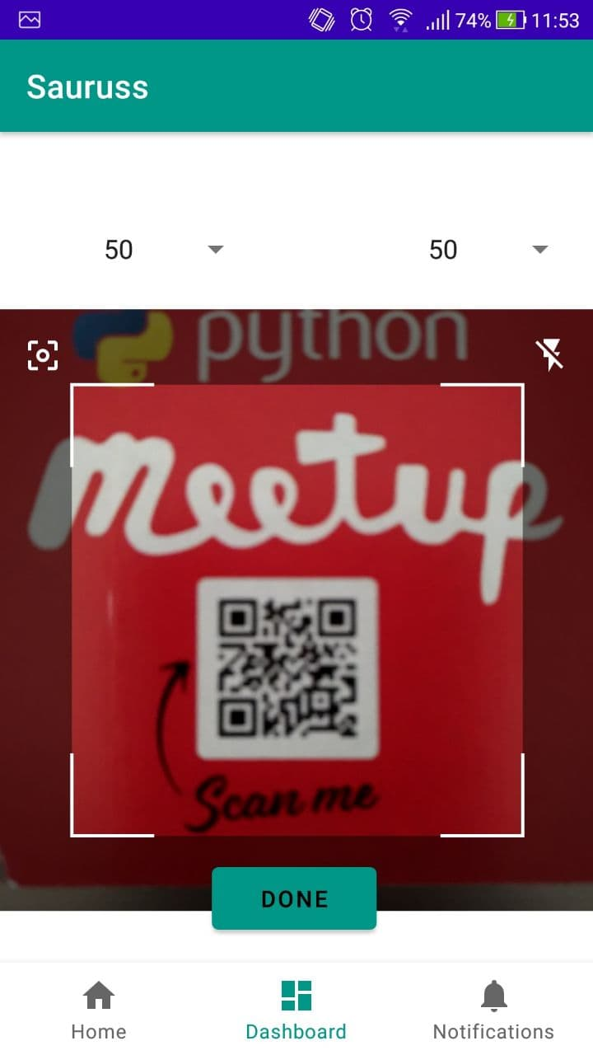
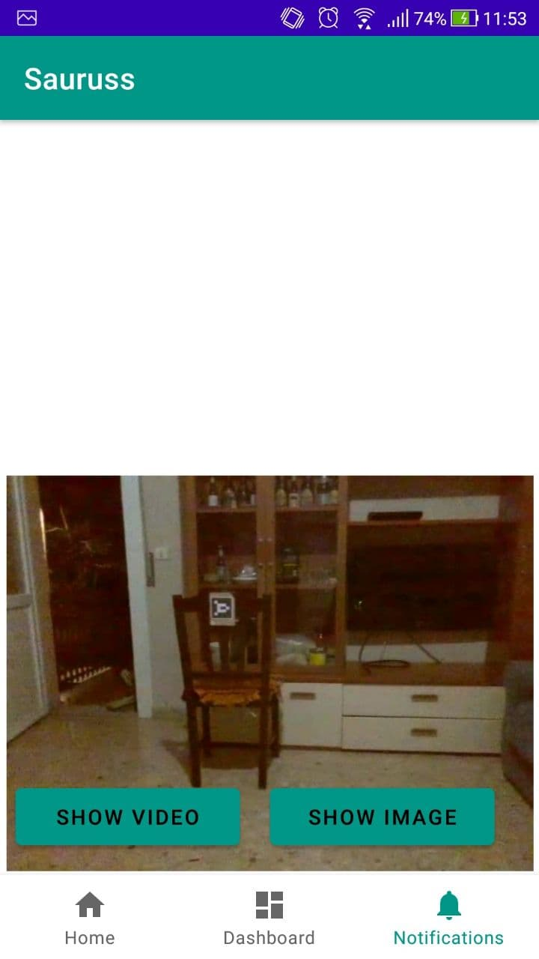
Smartphone Application

Slide 31
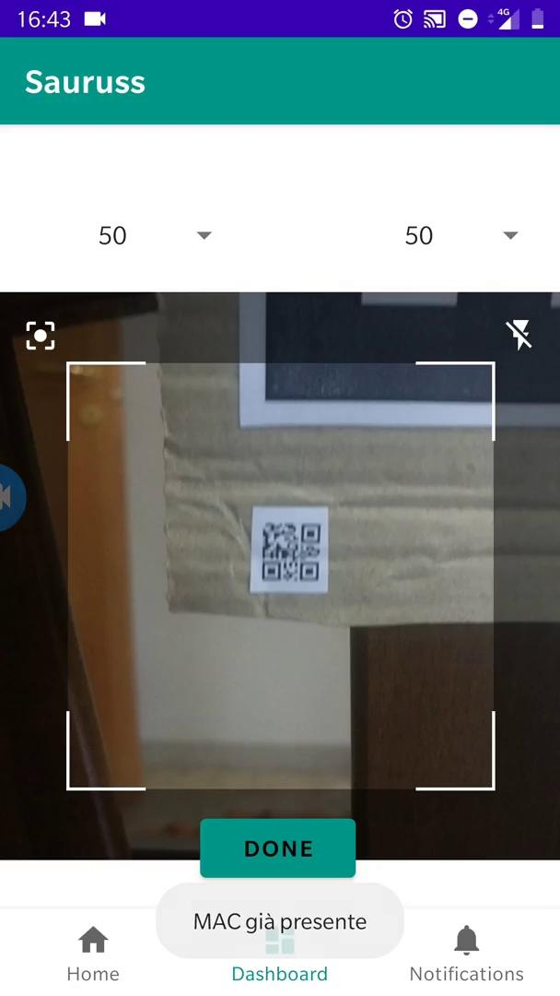
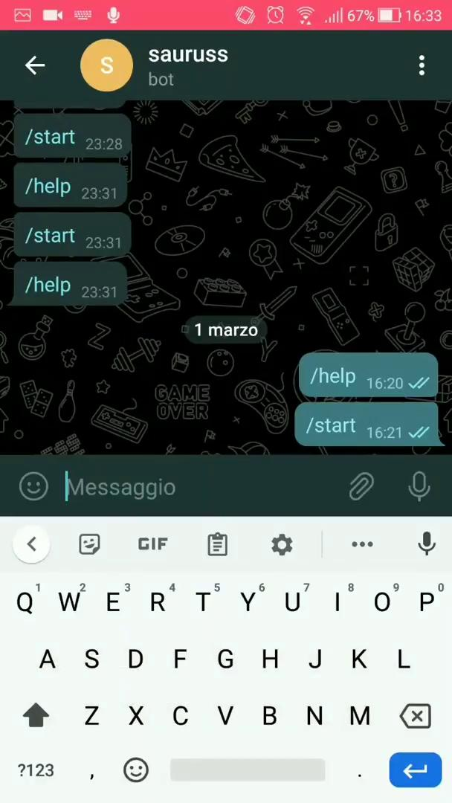
Setup & Configuration

Slide 32
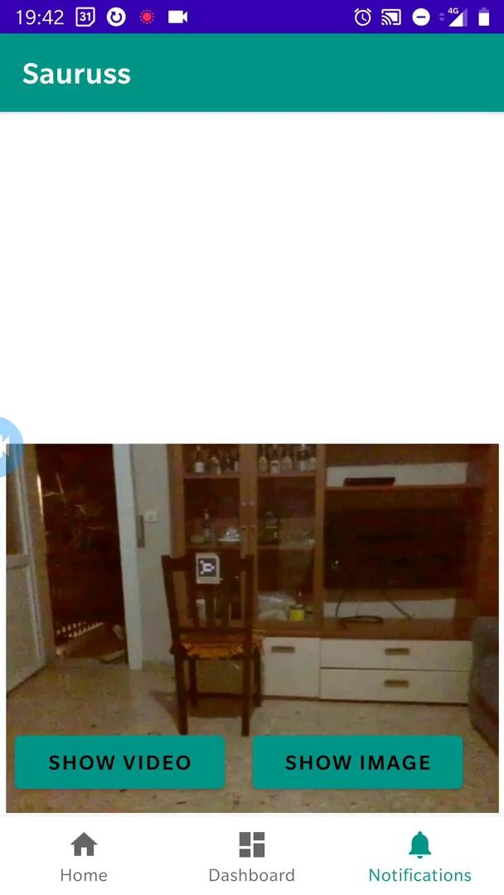
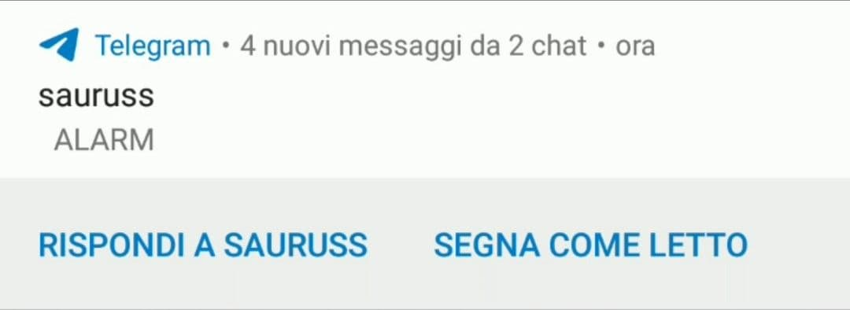
Notification

Slide 33
API – Application side (general)
Name | function
AndroidManifest | required to declare the app’s package name, components of the app and necessary permissions for the app to work properly
UserInfo | used to set and retrieve the global variables of the current session, that needs to be shared throughout all the app
LoginActivity* | start activity of the app. Handles the login of the user and saves cookies.
MainActivity | redirects to home page of the app and handles the whole bottom navigation
Home | handles home view to show stats and/or recap of current state (once enough data will be collected)
Dashboard* | setup/modify position and id of the sensor used in the project
Notification* | shows last video/image captured by the drone
*next slide for specific info

Slide 34
API – Application side (specific)
File | Function | Request
LoginActivity | onCreate( ) | HTTP POST request to submit login form or if response != 200 HTTP POST to register a new user
Dashboard Fragment | scanFunction( ) | on QR code decoded makes HTTP POST request to submit the decoded value(MAC address of the device) to sensors
 | dbCall(parameters) | parameters: MAC address and relative positions of the sensor manually selectionable. does: on clicking the button “done” makes an HTTP POST request to submit the parameters to distances
Notification Fragment | getFileName( ) | HTTP GET requests to get the timestamp and ID of the sensor that triggered an alarm and so the filename of video and image captured by the drone
 | downloadFile(Url,saveDir) | HTTP GET request to download video and image captured by the drone on alarm trigger

Slide 35
BOT Telegram API
Function | Description
ON_Command | on the user command “/on” puts FSM state to sense_mode, therefore turning on the sensors
OFF_Command | on the user command “/off” puts FSM state to off, therefore turning off the sensors and shutting down the alarm. (User should send this if has already checked the view notifications on the app and it’s all ok)
send_alert_message* | when an alert occurs, makes a request to the telegram server in order to notify the user
send_bot_message* | send feedbacks to the user(through a request to telegram server) about sensors having been switched on succesfully or not
get_new_message | on configuration, user has to type “config” + “ “ + username + “ “ + password on the bot chat. this function checks if all is typed correctly and then uses username and password to retrieve the mac adresses from the db and configure their connection with the bridge
*each request to the telegram server requires chatID and BOTKEY

Slide 36
Backend and Bridge Drone Automation

Slide 37
Raspberry Pi bridge
Bridge is the center of the drone’s decisions and also of the frame elaboration done by the camera. From here, all the HTTP requests to the SAURUSS flask server are sent.
This happens when an alarm event is generated somewhere in our sensor network.
Visual and Object recognition activities are based on AI algorithms.

Slide 38
API – Bridge [PACKAGE] HTTP_Session:
SESSION_SERVICE | REQUEST | DESCRIPTION
doLogin(user,password) | s.post(URI + “login/<user>/<psw>/”) | For each request, a login by the bridge of a specific user is required
getDistances() | s.get(URI+’distances/’) | A request to update the new sensor coordinates
uploadMediaFile (sensore,data,file) | s.post(URI+ ‘upload/<sensor>/<data>/’, file={‘media’:<file>}) | Sending photos and videos in the moment of intrusion by the drone
sendAlarmBySensorID (sensor) | s.post(URI+ ‘alarms/<sensor>/’’) | Sending the alarm with timestamp
getTimestamp(sensor) | s.get(URI+’alarms/timestamp/<sensor>/’) | Returns the timestamps of the last alarm
URI | “http://thomasgar.ns0.it/” | Server SAURUSS

Slide 39
API – HTTP protocol
Type of Request | Route | Description
POST | /login/{username}/{password} | -
GET | /logout | -
POST | /registration/{nomeutente}/{password}/{phone}/ | SQLAlchemy provides encryption
POST | /upload/{alarm_id}/{date}/ | Store media files on SAURUSS server
GET | /download/{date}/{filename}/ | Get the URL on DB and then start to download from server
GET | /alarms/ | It provides the history of the past alarms
POST | /sensors/{sensor_id}/{latitude}/{longitude}/ | Insert a new sensor on DB
POST | /distances/{sensor_id}/{x_position}/{y_position}/ | Changes a sensor distances from the drone home

Slide 40
E/R database MySQL
The modularity of implementation of the connection to the database allows it to be accessible anywhere and therefore can reside on the server or on another separate machine.
User (id, VARCHAR(50) PK; password, TEXT; user_phone, TEXT)
Sensor (sensor_id, VARCHAR(50) PK, user_id, VARCHAR(50) FK(User); latitude, TEXT; longitude, TEXT)
Distances (sensor, VARCHAR(50) FK(Sensor); x_axis, INT; y_axis, INT)
Alarm (alarm_id INTAUTOINCREMENT PK, sensor_id VARCHAR(50) FK(Sensor), timestamp, DATETIME, media, TEXT)

Slide 41
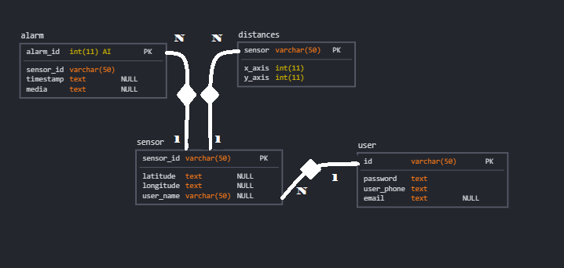
E/R database MySQL

Slide 42
Threads description
In order to perform the self-piloting movements of the drone, for the simultaneous execution of the visual recognition (objects and aruco pose estimation in 3D space), and finally for the handler of the Telegram bot it was necessary to implement a multithreaded code, as well as a solid task orchestration.
[Package] Autonomous Driving
-Recognition Thread: YOLO performs a neural network described later
-Rotation Thread: These threads work together
- RTH(Recognition) : YOLO
[Package] Bridge Comm
- Bot (telegram): It constantly polls the Telegram server

Slide 43
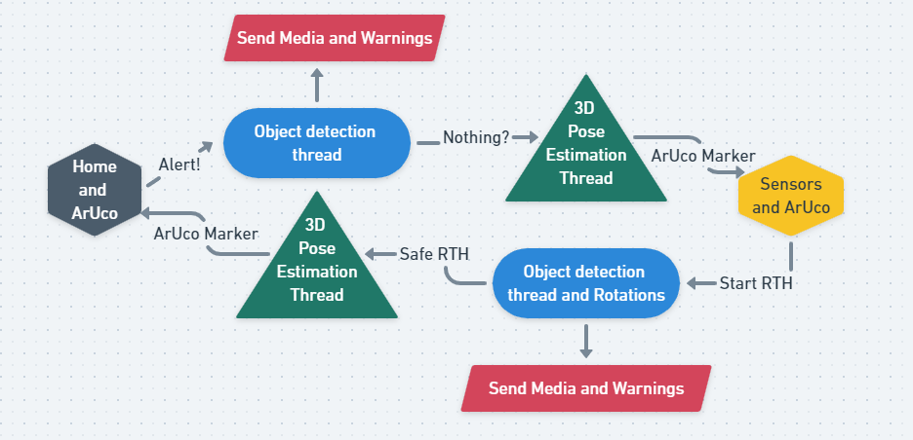
Graphic description

Slide 44
YOLO: [PACKAGE] Object_Detection
The deep learning side of the project is definitely YOLO, a convolutional neural network that allows objects to be recognized thanks to computer vision algorithms.
In detail:
-Configurations: "yolov3-tiny.cfg"
- Weights: "yolov3-tiny.weight"
It was decided to use the TINY version of the weights and the configuration in order to cope with the bridge calculation limits.
At the exact moment of recognition of a person, a photograph is taken as proof and a short video.

Slide 45
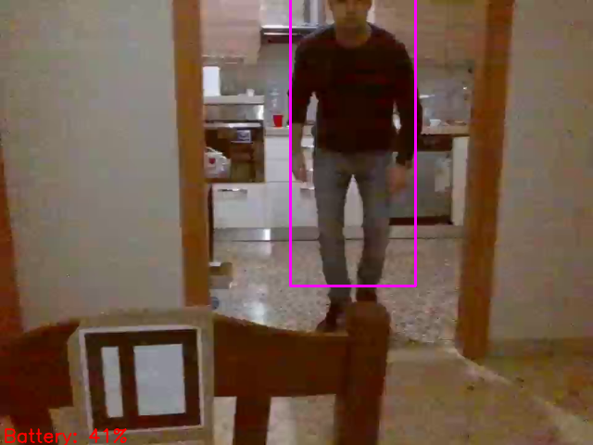
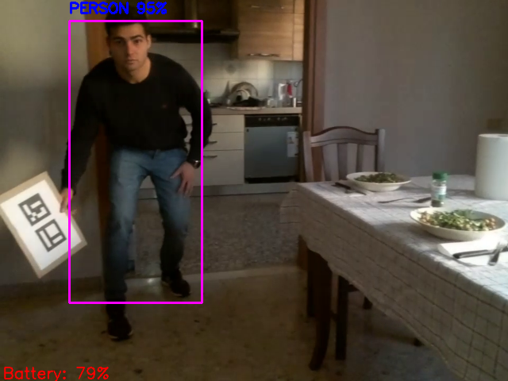
YOLO examples

Slide 46
3D Pose Estimation
To cope with the problem of missing GPS and the problems of instability of the drone it was necessary to implement a system of pose estimation in the operating space. Position estimation is of great importance in many computer vision applications: robotic navigation, augmented reality and many others.
Used technologies:
-Camera Calibration (openCV)
-ArUco markers (openCV)
-Euler Angles Rotations (openCV)

Slide 47
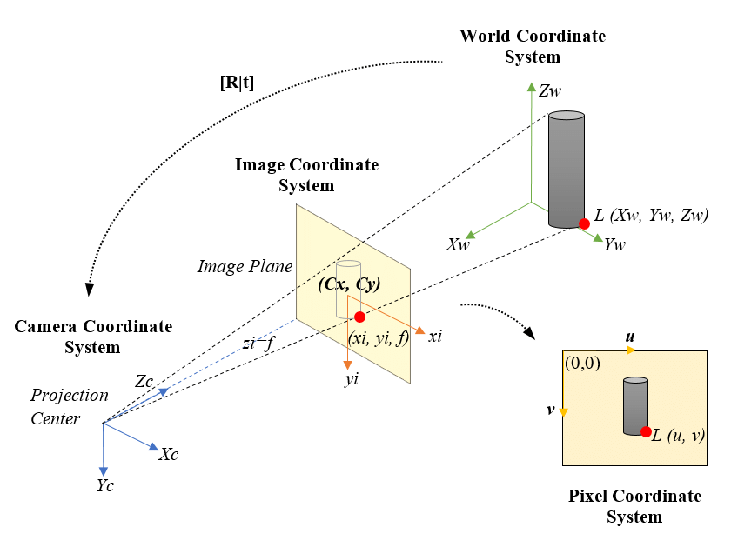
Pinhole camera model
The pinhole camera model describes the mathematical relationship between the coordinates of a point in three-dimensional space and its projection onto the image plane of an ideal pinhole camera, where the aperture of the camera is described as a point and no lenses are used to focus the light.

Slide 48
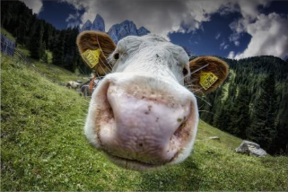
Distortion problem
The pinhole camera model does not include, for example, geometric distortions or blurring of blurred objects caused by lenses and apertures of finite size.

Slide 49
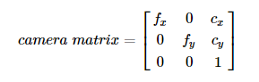
Camera Calibration
Calibration is necessary in order to derive the intrinsic parameters of the camera, such as:
- Distortion of the image (lens curvature).
-Focal length
-Optical center

Slide 50
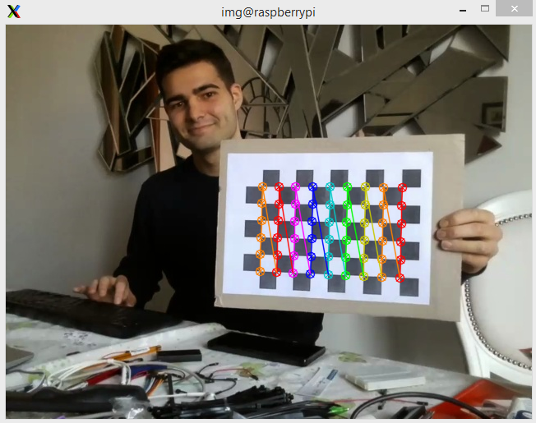
Chessboard
The calibration of the drone camera was done using a 9x6 chessboard (number of intersections between chess).

Slide 51
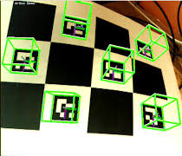
ArUco Markers
The main advantage of these markers is that a single marker provides enough matches (its four corners) to achieve the camera pose. In addition, the internal binary coding makes them particularly robust, allowing the possibility of applying error detection and correction techniques.

Slide 52
ArUco marker pose estimation
Pseudo code
rot = aruco.estimatePoseSingleMarkers (corners, marker size, camera matrix, camera distortion)
returns a matrix from which the rotation and translation vector can be extrapolated (rvec, tvec)
Rot_matrix = cv2.Rodriguez(rvec)
defines rotation on an axis with a vector (v * theta)
roll, pitch, yaw = rotationMatrixToEulerAngles(Rot_matrix.T)

Slide 53
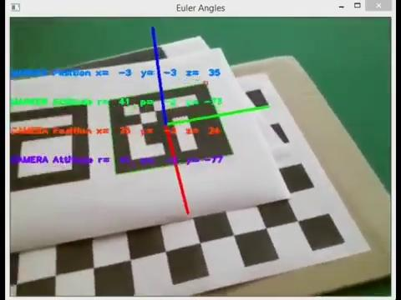
ArUco marker pose estimation

Slide 54
DJI Tello Drone
Tello is the drone was used in the prototype. It’s a small drone (80g) and it's easy to program.
Specs:
Weight: 87g (Propellers and Battery Included)
Dimensions: 98×92.5×41 mm
Propeller: 3 inches
Built-in Functions: Range Finder, Barometer, LED, Vision System, 2.4 GHz 802.11n Wi-Fi, 720p Live View
Port: Micro USB Charging Port
Photo: 5MP (2592x1936)
FOV: 82.6°
Video: HD720P30
Format: JPG(Photo); MP4(Video)
EIS: Yes

Slide 55
Tello SDK 2.0
To interact with the drone you must use the functions defined in the tello sdk.
These are some of the elementary movements:
-tello.move(dir, dist)
-tello.go(x,y,z,speed)
-tello.rotate_counter/clockwise(theta)
-tello.takeoff()
-tello.land()
with tello.get_time_of_flight() you can estimate the distance traveled. but it’s not accurate for environmental agents.

Slide 56
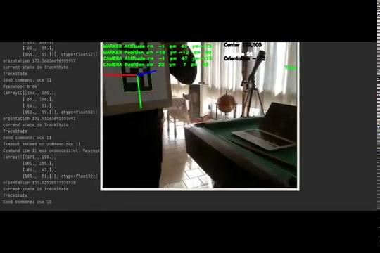
Tello drone pose estimation and tracking

Slide 57
DEMO

Slide 58
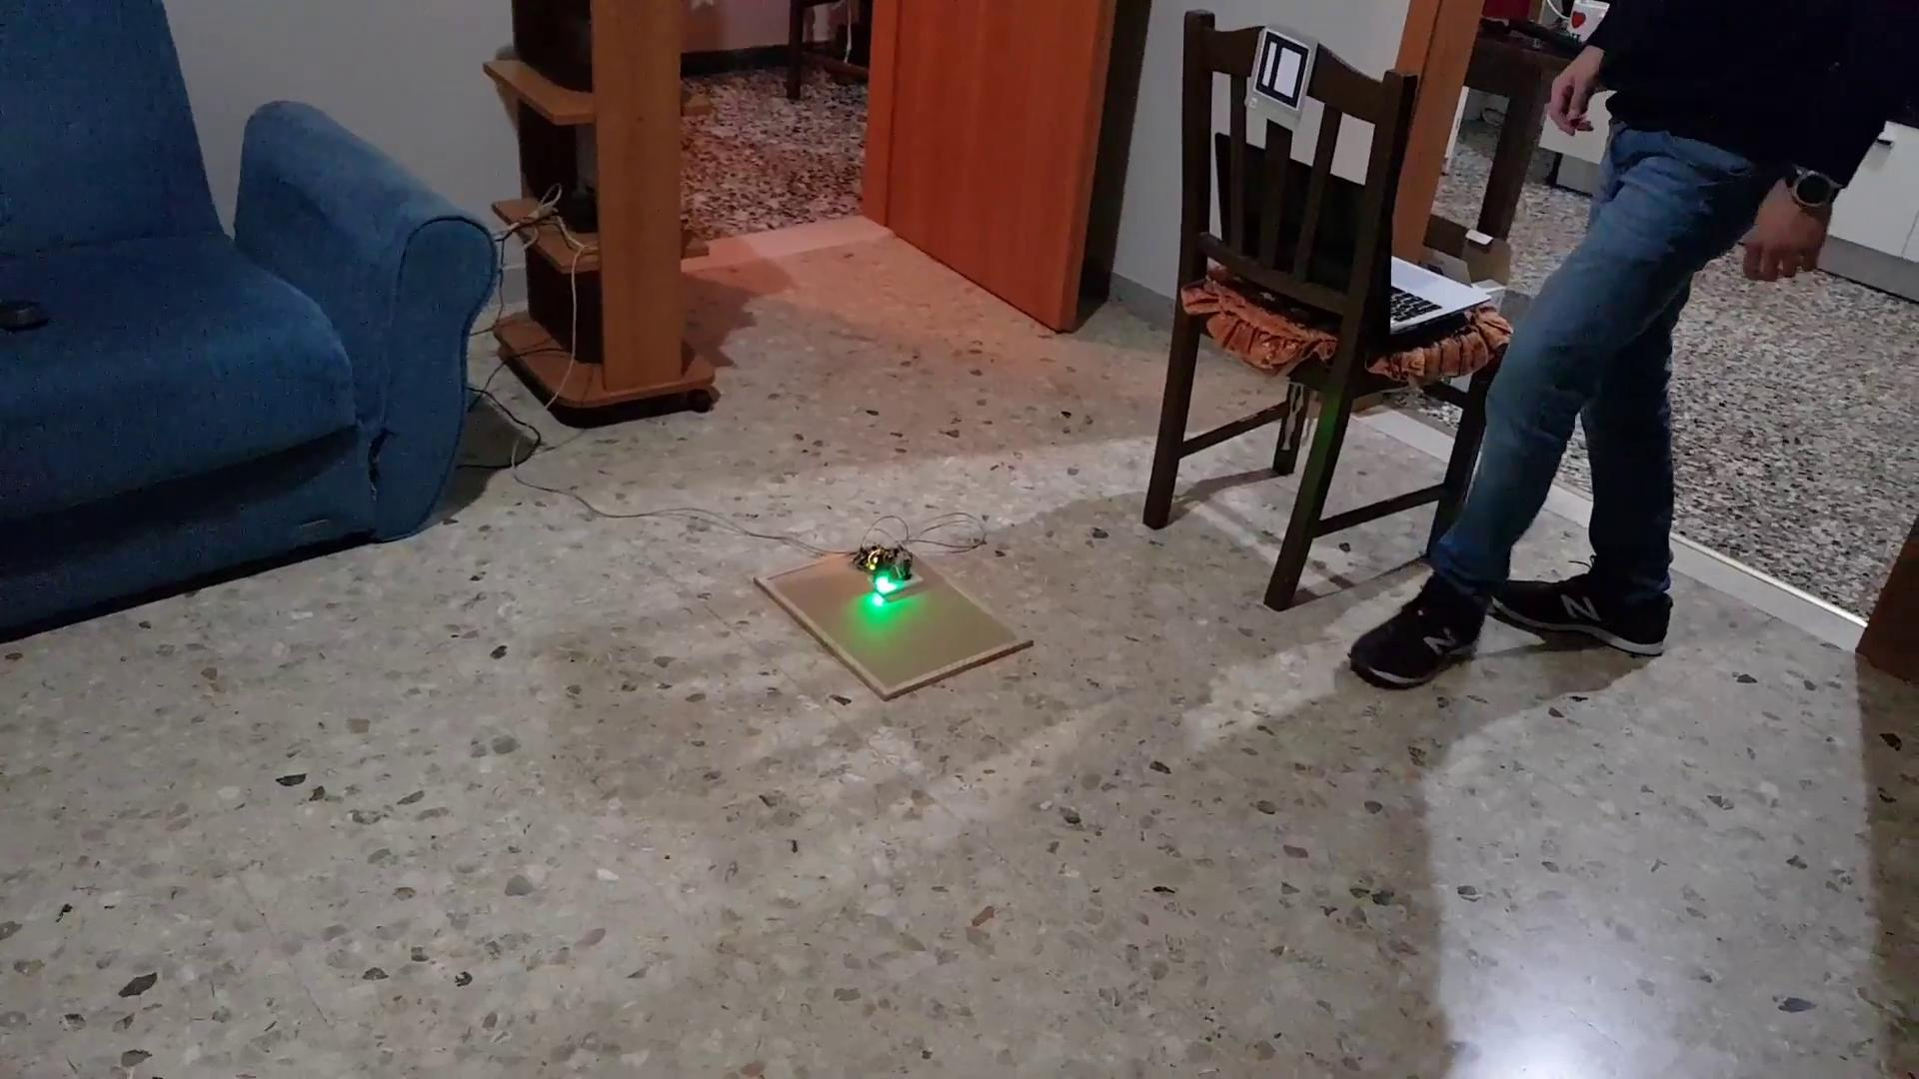

Slide 59
Recap of future features we look forward to add
1.Alarm will be triggered no more by a threshold but using data saved as feature vectors and using a labeled dataset (with data collected through time) so that an anomaly detection becomes possible and the alarms system becomes more accurate
2. One single account will offer the possibility to connect to multiple SAURUSS
3. Drone will have GPS integrated so relative distances selected with a picker on the app will be replaced by current gps position(longitude,latitude) of the sensor, taken automatically on qr code scanning with the app
4. Collecting data of the single user we will be able to show him an history of what happened since he bought SAURUSS
5. Collecting together data from multiple SAURUSS of different users we will be able to do separate statistics about intrusions, statistics based on time and also zone
6. We will improve the drone movements including features of obstacle avoidance

